Slide 1
Specification (I): what we have and what we want
SOFTWARE ENGINEERING · LECTURE 2 · W3 · 12–16 OCT
Resources, constraints, risks, and finding out what is actually needed
Rareș Cristea · FMI-UB · 2026–27
1 / 37
Notes:
Lecture 2 opens the specification block: this week 'what we have' and 'what we want', the first half of next week 'does it hold?'. Main sources: Sommerville, Software Engineering, 10th ed., chapters 4, 22 and 23; Richards and Ford, Fundamentals of Software Architecture, chapters 20 and 23. Every slide gives the book pages in its footer; the reading list at the end is what the quiz and the project rubric are built on.

Slide 2
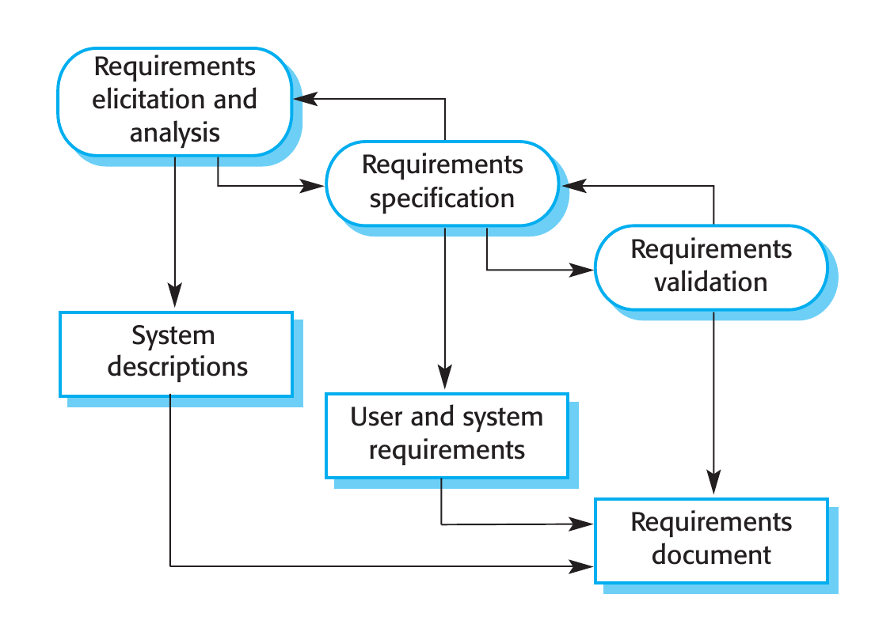
Specification joins analysis and planning
WHERE WE ARE
1 · Elicitation and analysis
Find out what the system should do.
2 · Specification
Write it down, at two levels.
3 · Validation
Check it is realistic, consistent, complete.
In lecture 1, the SDLC stages Analysis and Planning sat under one activity: Specification. That is where we are for the next week and a half.
Source: Sommerville, Software Engineering, 10th ed., §2.2.1 and Figure 2.4, p. 54–55.
2 / 37
Notes:
Recap from lecture 1. Sommerville describes three main activities of requirements engineering: elicitation and analysis, specification, validation. In the course's SDLC grouping, Analysis and Planning both belong to Specification. Sommerville notes that a feasibility study may come before all of this, and that in agile the activities are interleaved and done per increment.

Slide 3
When code is cheap, what stays expensive?
Knowing what you build, and with what. A requirements error means changing the requirement, then the design, the implementation and the tests.
Source: Sommerville, Software Engineering, 10th ed., §4.5, p. 129.
3 / 37
Notes:
Sommerville, p. 129: the cost of fixing a requirements problem by making a system change is usually much greater than repairing design or coding errors, because the design and implementation must also change and the system must be retested. With AI, writing the code got cheaper; deciding what to write did not. If the requirement is wrong, an agent produces the wrong system faster. Link to MDS lecture 2 (the economics of abstraction: when software gets cheaper, demand for it explodes): the other side of that coin is that deciding what to build becomes the expensive part.

Slide 4
Three questions before any architecture
TODAY AND NEXT WEEK
W3 · today
W3 · today
W4 · first half
What do we have?
What do we want?
Does it hold?
People, knowledge, technical and financial resources, access to AI. The constraints they set and the risks they carry.
Finding out the requirements: interviews, observation, stories and scenarios, and mining the system you already have.
Writing requirements down, checking they are realistic and consistent, resolving conflicts, managing change.
Then architecture starts, in the second half of W4. Workshop 1 (W5) confirms the direction of your project, built on today's two questions.
Software Engineering 2026–27 · Lecture 2
4 / 37
Notes:
The plan for the specification block. Today: what do we have and what do we want. Next week, first half: does it hold. Then the architecture lectures. Workshop 1 in W5 is where each team's direction is confirmed, so the optional homework at the end of today prepares exactly that discussion.

Slide 5
Ever built the right code for the wrong requirement?
DISCUSSION
Working software, tests passing, and still not what was needed.
Software Engineering 2026–27 · Lecture 2
5 / 37
Notes:
Free discussion, about 5 minutes. A story from experience: a project where the code was fine but the requirement was misunderstood or wrong. Ask the room whether anyone had this at MDS. Bridge: today is about catching this before the code exists.

Slide 6
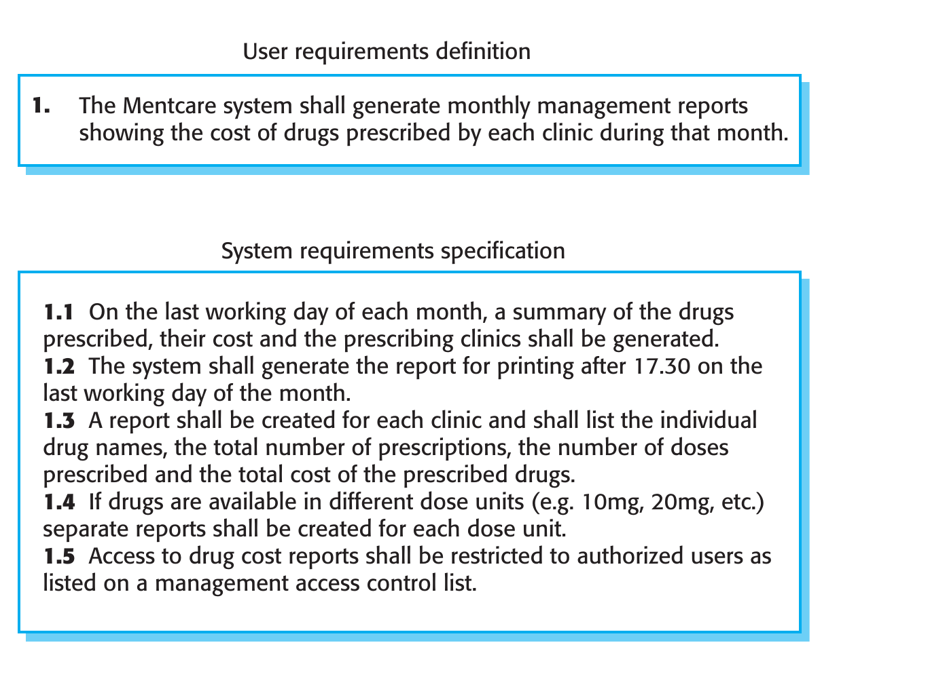
What you already know from MDS
RECAP FROM MDS
Requirements: “the descriptions of the services that a system should provide and the constraints on its operation.”
User vs system requirements two levels, two audiences
Functional vs non-functional with metrics for NFRs
User stories with acceptance criteria, backlog with AI
Today builds on this. New: whether it's worth doing, what you have to do it with, and where requirements actually come from.
Sources: Sommerville, Software Engineering, 10th ed., p. 102–103, Figure 4.1; MDS 2026, lecture 2 (requirements).
6 / 37
Notes:
Recap only: at MDS, lecture 2 (after Sommerville), you saw user vs system requirements, functional vs non-functional requirements with a table of NFR types and metrics, and you wrote at least 10 user stories with acceptance criteria and a backlog generated with AI. We don't repeat any of that. Figure 4.1 (Mentcare) as a reminder: one user requirement, five system requirements. Requirements engineering = finding out, analyzing, documenting and checking (p. 102). Today is about the first verb, and about what comes before it: feasibility and resources.

Slide 7
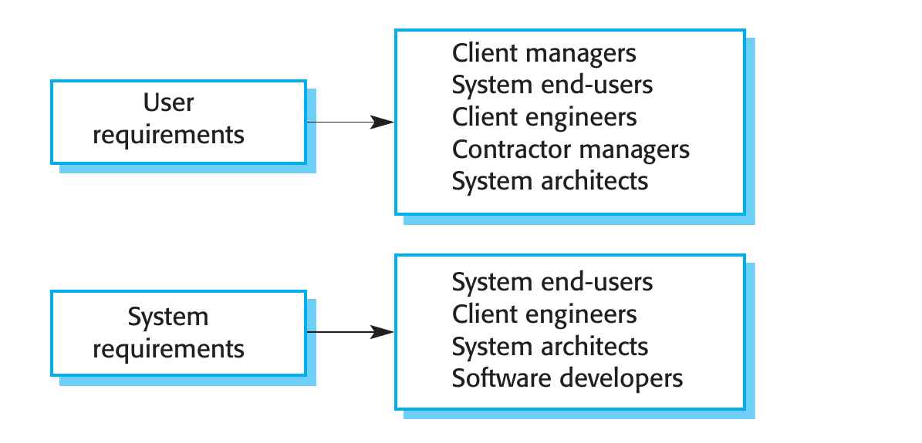
Personas use it. Stakeholders are affected by it
BEYOND PERSONAS
Stakeholder
“Anyone who is affected by the system in some way and so anyone who has a legitimate interest in it.”
Mentcare: patients and relatives, doctors, nurses, receptionists, IT staff, a medical ethics manager, health care managers, medical records staff.
At MDS you described personas: the people who use the system. Who are the stakeholders of your MDS system, and who actually has an interest in it now?
Source: Sommerville, Software Engineering, 10th ed., p. 103–104, Figure 4.2.
7 / 37
Notes:
Different readers need different levels: client managers read user requirements, developers read system requirements. Stakeholders range from end-users to regulators. At MDS students wrote personas, which describe users; stakeholders are a wider set, including people who never touch the system (regulators, an ethics manager, the people who pay). Rhetorical question for the room, no need to collect answers: for an MDS project, the original 'users' may have been imaginary; this year it's worth asking who really has an interest. This goes into the optional direction sheet.

Slide 8
Is it worth doing? Three questions
BEFORE ANYTHING
1
2
3
Does it contribute to the organization's overall objectives?
Can it be built within schedule and budget, using current technology?
Can it be integrated with the other systems already in use?
“If the answer to any of these questions is no, you should probably not go ahead with the project.” Question 2 is the next part of today.
Source: Sommerville, Software Engineering, 10th ed., box “Feasibility studies”, p. 104.
8 / 37
Notes:
A feasibility study is short and focused, early in the RE process. The three questions are Sommerville's. The second one, schedule, budget and technology, is exactly what 'what do we have' is about: we can only answer it if we know our resources.

Slide 9
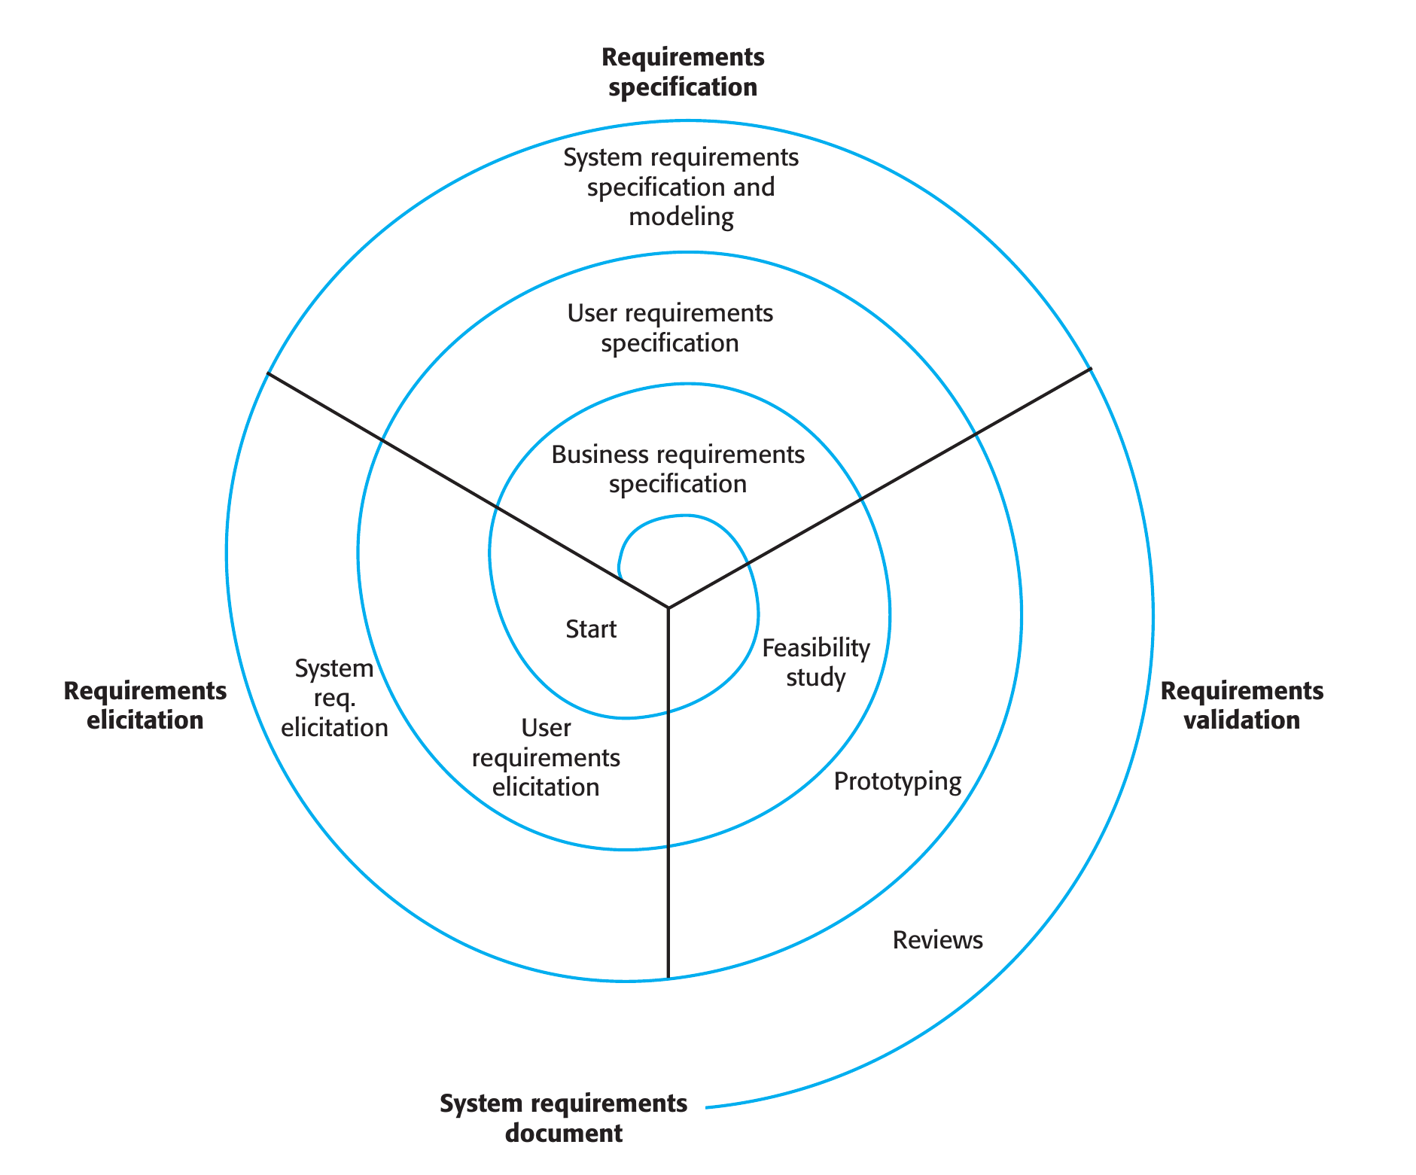
Requirements engineering is a spiral
NOT A STAGE
How to read it
Elicitation, specification and validation are interleaved, round after round.
Early rounds: business and user requirements. Outer rounds: non-functional and detailed system requirements.
The feasibility study sits at the very start.
The number of rounds varies; in agile, requirements and implementation grow together.
Requirements change in virtually all systems: changes have to be managed.
Source: Sommerville, Software Engineering, 10th ed., §4.2, p. 111–112, Figure 4.6.
9 / 37
Notes:
Figure 4.6 replaces the sequential view of Figure 2.4. The time spent on each activity depends on the stage, the type of system and the budget. Today we are in the inner rings: feasibility and user requirements elicitation. Change management (requirements management) comes next week.

Slide 10
What we have
PART 1
Resources, constraints, and the risks they carry
Software Engineering 2026–27 · Lecture 2
10 / 37
Notes:
First part: the resources. This is the 'planning' half of specification.

Slide 11
Planning starts with constraints
PLANNING STARTS HERE
01
02
03
04
Delivery date
Staff available
Overall budget
Available tools
When must it work?
Who, and how many hours?
What can we pay for?
What do we work with?
“You should make realistic rather than optimistic assumptions when you are defining a project plan.” Problems always arise, so include contingency.
In Sommerville's planning process, the first step is “Identify constraints”, before risks and milestones.
Source: Sommerville, Software Engineering, 10th ed., §23.2.2, p. 673–674.
11 / 37
Notes:
Sommerville, p. 674: at the beginning of planning you assess the constraints: required delivery date, staff available, overall budget, available tools. Assumptions should be pessimistic rather than optimistic, with contingency in the plan. For student teams the classic optimistic assumption is the number of hours each member will actually put in.

Slide 12

Five kinds of resources
THE COURSE'S INVENTORY
People who, how many hours
Knowledge what the team knows, and doesn't
Technical stack, environments, services
Financial effort, licences, hosting
A pragmatic architect weighs budget, time, the skill set and skill level of the team, trade-offs, technical limitations.
Access to AI models, limits, data rules
The grouping into five is the course's. The textbooks give the pieces: cost parameters (Sommerville) and the pragmatic constraints (Richards & Ford).
Sources: Sommerville, Software Engineering, 10th ed., p. 669; Richards & Ford, 2020, Figure 23-3, p. 355–356.
12 / 37
Notes:
The five categories are how we organize the inventory in this course. Sommerville lists the cost parameters of a project (effort; hardware and software; travel and training). Richards and Ford, in 'Be pragmatic, yet visionary', list the factors a pragmatic architect takes into account: budget, time, skill set and skill level of the team, trade-offs, technical limitations. The next slides take the five one by one.

Slide 13
People: count hours, not heads
RESOURCE 1 · PEOPLE
4–6
Realistic hours
Key people
How many hours per week will each member actually put in, in which weeks? Exams, jobs, other projects. Plan with the pessimistic number.
In agile teams, with little documentation, losing a key person hurts continuity the most. Who is the only one who knows how part X works?
the best size for a software engineering group; never more than 12
Staff turnover and key staff unavailable at critical times are on every list of common project risks.
Source: Sommerville, Software Engineering, 10th ed., p. 646–648 and p. 656.
13 / 37
Notes:
Sommerville p. 656: the best size for a software engineering group is 4 to 6 members, never more than 12. Your teams are 4 to 5. p. 647: agile reduces some risks but, relying on people and informal communication, makes staff turnover more damaging. Figure 22.1 and 22.3 list staff turnover and key staff ill at critical times among the common risks.

Slide 14
What nobody on the team knows is a risk
RESOURCE 2 · KNOWLEDGE
9
“For unproven or unknown technologies, always assign the highest risk rating (9) since the risk matrix cannot be used for this dimension.”
the risk score for an unknown technology, out of 9
The Redis story
In a risk session, one participant rated the Redis cache as high risk. Asked why: “What is a Redis cache?” Not knowing a technology is information about risk.
Inventory both sides: what the team masters, and what it would be using for the first time.
Source: Richards & Ford, Fundamentals of Software Architecture, 2020, ch. 20, p. 306.
14 / 37
Notes:
Richards and Ford, chapter 20, in the risk storming consensus step: one participant rated the Redis cache 9 while nobody else saw a risk; the reason was that they didn't know what Redis was. The authors' rule: unknown or unproven technology gets the highest rating, 9. The matrix itself comes in a few slides.

Slide 15
Technical and financial resources
RESOURCES 3 AND 4 · TECHNICAL, FINANCIAL
Technical
Financial
Stack and environments: development, test, production.
CI, hosting, external services and their limits.
A project plan has its own section: “hardware and software resource requirements”.
Effort costs: usually the biggest.
Hardware and software costs, licences and support included.
Travel and training costs.
“The fixed factor in many projects is not the project requirements but the cost.” Requirements get negotiated to fit the budget.
Source: Sommerville, Software Engineering, 10th ed., p. 669, p. 671, p. 673.
15 / 37
Notes:
Sommerville p. 669: three parameters when computing costs: effort, hardware and software (including maintenance and licences), travel and training. p. 673: the project plan includes hardware and software resource requirements. p. 671, in the discussion of 'pricing to win': often the cost is fixed and the requirements are negotiated so the project stays within budget. For a student team the budget is often zero: say so explicitly, it's a constraint like any other.

Slide 16
Access to AI: a resource, but not a turnkey one
RESOURCE 5 · ACCESS TO AI
Capability
Cost
Data constraints
Not turnkey
Which models, on which plan, and who on the team has them. Usage limits.
Subscriptions and tokens. In Sommerville's terms: hardware and software costs.
What data may go into which model: personal data, the client's data, secrets.
An agent that can act needs what a new colleague needs: a role, a scope, sources of truth, someone to escalate to. Next slide.
In companies, too, access is budgeted and uneven: someone decides who gets which model. Planning with what you actually have is part of the job.
Course framing; cost category: Sommerville, Software Engineering, 10th ed., p. 669; “not turnkey”: Telang, Hydari, Iqbal, HBR, Sep–Oct 2026.
16 / 37
Notes:
This slide is the course's own framing; the textbooks predate AI assistants. Treat AI access like the other resources: what you have, what it costs, and what you are not allowed to put into it. The fourth card bridges to the next slide: Telang, Hydari and Iqbal (HBR, September–October 2026, 'To Scale AI Agents Successfully, Think of Them as Team Members') argue that agents should not be treated as turnkey software that only needs installing, but as a new kind of workforce that requires management. The list of tools available at no cost is posted on Teams, not repeated here. Reminder of the course design: a better model may produce a better project, which is why 50 points are earned without tools and the project is graded on what you can explain and defend.

Slide 17
Onboard the agent like a team member
RESOURCE 5 · ACCESS TO AI, CONTINUED
Identity and scope
Sources of truth
The autonomy ladder
Its own permissions, least privilege. In your repo: what may the agent touch? Can it push to main?
Which documents it trusts: the spec, the README, your direction sheet. Outdated context leads to wrong actions.
4
Bounded autonomy
acts alone, within narrow limits
3
Supervised actions
proposes, a person confirms
Hard boundaries
Accountability
2
Retrieval with guardrails
answers from governed sources
The agent proposes, deterministic checks decide: tests, CI, review before merge.
Someone owns what it does. Air Canada was held responsible for its chatbot's answer (Moffatt v. Air Canada, 2024).
1
Assistive output
drafts that humans review
A chatbot creates content risk: it might say something wrong. An agent creates execution risk: it might do something wrong.
Source: Telang, Hydari, Iqbal, “Think of Them as Team Members”, HBR, Sep–Oct 2026, p. 26–29; adapted.
17 / 37
Notes:
Telang, Hydari and Iqbal, 'To Scale AI Agents Successfully, Think of Them as Team Members', Harvard Business Review, September–October 2026, p. 26–29. Their claim: like human employees, agents need a role, a defined scope of authority, approved sources of truth and clear escalation rules, plus supervision and audit trails, because you will be accountable for their actions. They name four frictions: identity (agents on broad shared service accounts; least privilege and a traceable identity instead), context (bad or outdated data leads to bad actions; external inputs are attack vectors, e.g. prompt injection), control (probabilistic systems need deterministic checks: the agent proposes, rules verify before execution), accountability (records of what the agent read and did; clear internal ownership; Moffatt v. Air Canada, 2024, where the tribunal held the airline responsible for its chatbot's misinformation). The autonomy ladder: assistive output, retrieval with guardrails, supervised actions, bounded autonomy; many good deployments deliberately stay on the lower rungs. The article is about enterprises; the mapping to a student project (permissions in the repo, the spec and direction sheet as sources of truth, CI and review as the deterministic boundary) is the course's adaptation. Question for the room: on which rung is the coding agent in your MDS project?

Slide 18
Who decides who gets which model, and what may go into it?
DISCUSSION
How access to AI is planned, paid for and restricted in a real organization.
Software Engineering 2026–27 · Lecture 2
18 / 37
Notes:
Free discussion, about 5–10 minutes. From experience: how an organization decides who gets which licence, what it costs, what data may not go into a model and why. The point for students: resource limits are normal in industry too; engineering means planning within them.

Slide 19
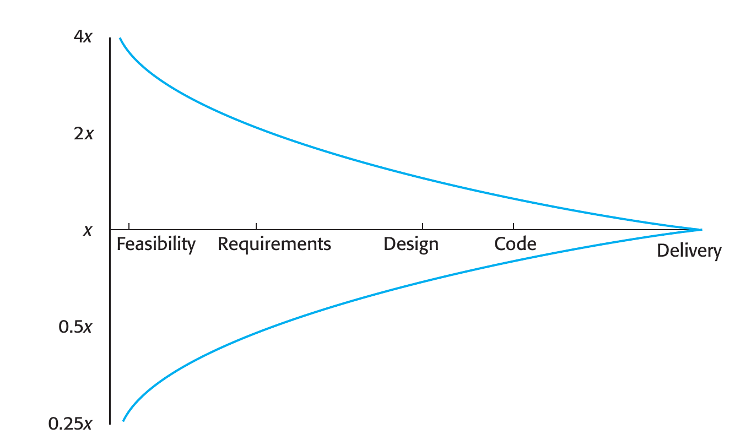
Early estimates are wide and self-fulfilling
ESTIMATION
0.25x to 4x
At the feasibility stage, the actual effort ranged from a quarter to four times the estimate (Boehm et al.).
Self-fulfilling
The estimate becomes the budget, and the product is adjusted to fit it, often at the expense of features.
Sommerville measures size in lines of code. Question for you: what does the “size” of a system mean when the code is generated?
Source: Sommerville, Software Engineering, 10th ed., §23.5, p. 682–685, Figure 23.9.
19 / 37
Notes:
Figure 23.9, the estimate uncertainty curve: based on Boehm et al. 1995, if the initial estimate is x, the actual effort ranged from 0.25x to 4x; estimates improve as the project progresses. p. 684: project estimates are often self-fulfilling. The closing question has no answer in the book: algorithmic models use lines of code as the size metric; with generated code, lines are cheap and say little about effort. Open the question, don't close it.

Slide 20
Resources turn into risks
FROM RESOURCES TO RISKS
What a risk affects
Six types to check, with Sommerville's examples
Project
schedule or resources
Product
quality or performance
Business
the organization
Estimation
The time required to develop the software is underestimated.
Organizational
Financial problems force reductions in the project budget.
People
It is impossible to recruit staff with the skills required.
Requirements
Changes that require major design rework are proposed.
Technology
The database cannot process as many transactions as expected.
Tools
The code generated by code generation tools is inefficient.
Source: Sommerville, Software Engineering, 10th ed., §22.1, p. 644–648, Figures 22.1 and 22.3.
20 / 37
Notes:
Two complementary classifications. By what the risk affects: project, product, business (p. 644–645). By type, as a checklist for identification: estimation, organizational, people, requirements, technology, tools (p. 647, examples from Figure 22.3). The tools example was written for the 10th edition, before AI coding assistants: 'the code generated by software code generation tools is inefficient'.

Slide 21
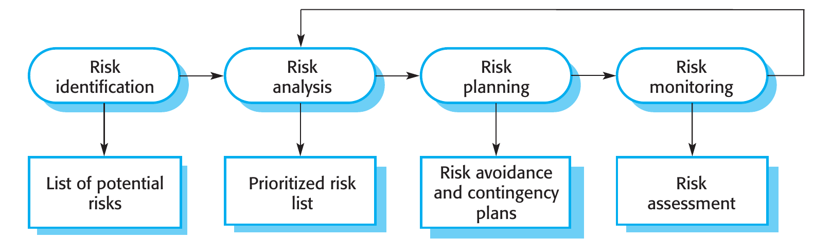
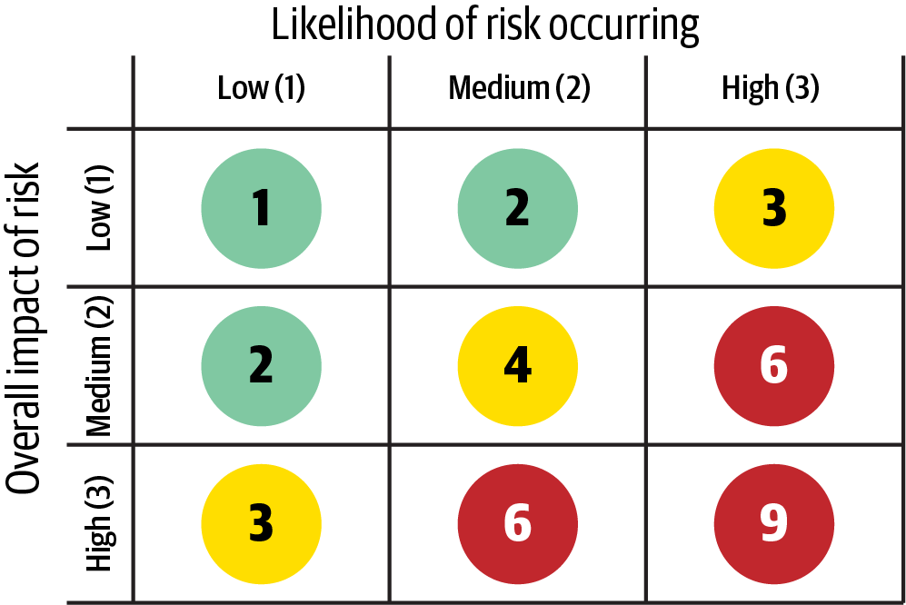
Identify, analyse, plan, monitor
ANALYSING RISK
Analysis without false precision
Precise numbers are impossible. Use bands: probability from insignificant to very high, effects from insignificant to catastrophic. Monitor all catastrophic risks and the serious ones above moderate.
Impact × likelihood, 1–9. Rate the impact first, then the likelihood.
Sources: Sommerville, Software Engineering, 10th ed., p. 646–650, Fig. 22.2; Richards & Ford, 2020, Fig. 20-1, p. 297–298.
21 / 37
Notes:
Sommerville's process: identification, analysis, planning, monitoring, iterated through the project. For analysis he uses bands rather than numbers. Richards and Ford's matrix makes the bands simple: impact and likelihood each low (1), medium (2), high (3), multiplied: 1–2 low, 3–4 medium, 6–9 high. Their advice: consider the impact first, then the likelihood. We use this matrix in the direction sheet.

Slide 22
Ask “what if”, then pick a strategy
PLANNING FOR RISK
01
02
03
Figure 22.5, 2016
Avoidance
Minimization
Contingency
For “underestimated development time”, the suggested strategy: “Investigate buying-in components; investigate use of automated code generation.”
Reduce the probability that the risk arises.
Reduce the impact if it does arise.
Be prepared for the worst, with a plan ready.
What if two people are ill in the same week? What if the only expert on a library leaves? What if the client sends the revised requirements late?
Source: Sommerville, Software Engineering, 10th ed., §22.1.3, p. 650–651, Figure 22.5.
22 / 37
Notes:
p. 650: in risk planning you ask what-if questions about individual risks, combinations and external factors. Three strategies: avoidance (lower the probability), minimization (lower the impact), contingency plans (be ready for the worst). Best to avoid; if not, minimize; and always have a way to cope. The Figure 22.5 example is worth a smile: in the 2016 edition, automated code generation was already a strategy against underestimated time.

Slide 23
Three risks of a typical MDS project
WORKED EXAMPLE
Likelihood →
R1 · People · 3×2 = 6
← Impact
1
2
3
Only one member understands the LLM integration. Minimize: pair on it, write down how it works.
2
4
6
R2
R2 · Tools · 2×2 = 4
The free tier of the model API changes or runs out mid-semester. Contingency: stub in CI, a local model as fallback.
3
6
9
R1
R3
R3 · Knowledge · 9
Nobody has used the end-to-end testing tool the team picked. Avoid: a short spike in the first week, or a tool someone knows.
Illustrative example. Methods: Sommerville, Software Engineering, 10th ed., p. 647–651; Richards & Ford, 2020, p. 297–298, 306.
23 / 37
Notes:
An invented but typical example, using the tools of the previous slides. R1 is a people risk with high impact and medium likelihood: 6, high. Strategy: minimization, spreading the knowledge. R2 is a tools risk, medium: contingency, since the course already asks for a stub in CI. R3 applies the Richards and Ford rule: unknown technology is rated 9 regardless of the matrix; avoidance by a spike early or by choosing a known tool. This is exactly the format of section 6 of the direction sheet.

Slide 24
What we want
PART 2
Eliciting requirements, and mining the system you already have
Software Engineering 2026–27 · Lecture 2
24 / 37
Notes:
Second part: elicitation, the 'analysis' half of specification.

Slide 25
Why eliciting requirements is hard
ELICITATION
1
Stakeholders don't know what they want: beyond general terms, and may ask for the unrealistic, not knowing what is feasible.
2
They speak their own language: with implicit knowledge of their work that engineers may not understand.
3
Different stakeholders, different requirements: expressed in different ways, with commonalities and conflicts to discover.
4
Political factors: a manager may demand a requirement because it increases their influence.
5
The environment changes: during the analysis itself; new stakeholders bring new requirements.
Source: Sommerville, Software Engineering, 10th ed., §4.3, p. 112–113.
25 / 37
Notes:
Sommerville's five reasons, p. 112–113. The fourth, political factors, is highlighted because it leads to the discussion that follows.

Slide 26
A requirement that came from politics, not from the problem
DISCUSSION
Who asked for it, why, and what it did to the system.
Software Engineering 2026–27 · Lecture 2
26 / 37
Notes:
Free discussion, about 5–10 minutes. A story of a requirement that had organizational or political reasons rather than technical ones. Link to Sommerville p. 116: interviews are not an effective way to learn about organizational requirements, because published structures rarely match how decisions are really made.

Slide 27
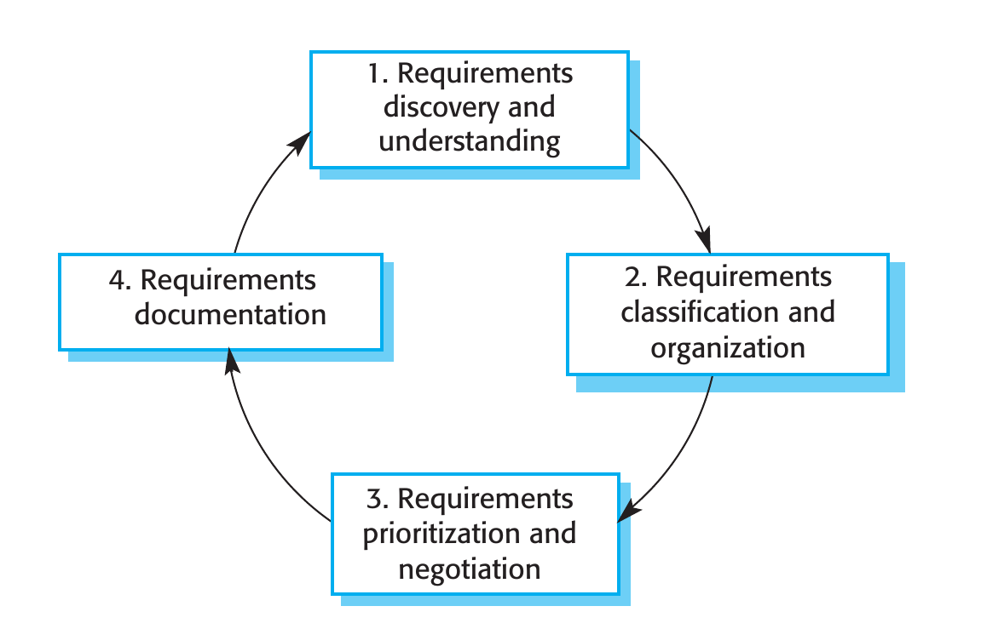
Elicitation and analysis, in four activities
THE PROCESS
The cycle
Discovery and understanding: talk to stakeholders, read documents, find domain requirements.
Classification and organization: group related requirements into coherent clusters.
Prioritization and negotiation: requirements will conflict; find and resolve the conflicts.
Documentation: write them down, input to the next round.
Today: discovery. Next week: classification, negotiation, documentation. Group what you find by viewpoint: stakeholders who have something in common.
Source: Sommerville, Software Engineering, 10th ed., §4.3, p. 113–114, Figure 4.7, box “Viewpoints”.
27 / 37
Notes:
Figure 4.7, the key figure for the specification block. The cycle starts with discovery and ends with documentation, and repeats; understanding improves each round. Sommerville recommends organizing by viewpoints (groups of stakeholders with something in common) and holding regular stakeholder meetings: those who feel ignored may undermine the process.

Slide 28
Interviews: start from something concrete
TECHNIQUE 1 · INTERVIEWING
Closed and open
Springboard
Predefined questions, or an open exploration. In practice a mix: completely open discussions rarely work.
“Tell me what you want” rarely works. Start from a question, a requirements proposal, or a prototype.
Jargon and tacit knowledge
What interviews miss
For a librarian it goes without saying that acquisitions are catalogued first. Nobody mentions it.
Organizational requirements and politics: people won't reveal the real decision structure to a stranger.
Be open-minded, avoid preconceived ideas, and combine interviews with other techniques: on their own, they miss essential information.
Source: Sommerville, Software Engineering, 10th ed., §4.3.1.1, p. 115–116.
28 / 37
Notes:
p. 115–116. Two types of interviews, mixed in practice. Two difficulties with domain knowledge: jargon, and knowledge so familiar it isn't mentioned (the librarian example). Interviews don't capture organizational constraints because of power relationships. To be an effective interviewer: be open-minded, and prompt with a springboard question, a requirements proposal or a prototype.

Slide 29
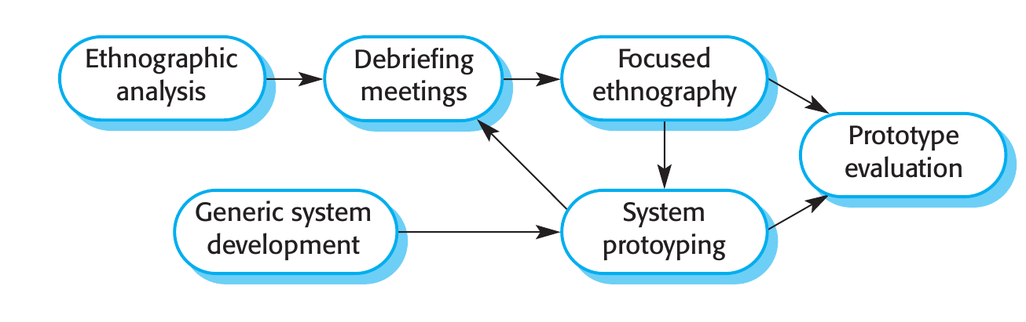
Ethnography: watch how people really work
TECHNIQUE 2 · OBSERVATION
Real work, not the formal process
Cooperation and awareness
Air traffic controllers may switch off a conflict alert system that is too sensitive, even though procedures say it should be used. A requirement nobody would state in an interview.
Controllers watch adjacent sectors to predict their own workload. A system should give that visibility.
Its limit
Understands what exists, doesn't invent. Nokia studied phone use; the iPhone ignored it.
Source: Sommerville, Software Engineering, 10th ed., §4.3.1.2, p. 116–118, Figure 4.8.
29 / 37
Notes:
Ethnography: the analyst immerses in the working environment. Effective for two kinds of requirements: those from how people actually work, and those from cooperation and awareness of others' activities (both air traffic control examples, p. 117). Combined with prototyping (Figure 4.8). Limit, p. 118: helps understand existing systems, not innovation; the Nokia vs iPhone comment is Sommerville's.

Slide 30
Stories give the picture, scenarios the detail
TECHNIQUE 3 · STORIES AND SCENARIOS
Story
Scenario: five parts
Narrative, high level. Example: a teacher in Ullapool needs a photo-sharing site for a class project on the fishing industry. Easy for anyone to relate to and comment on.
1
What the system and users expect when it starts
2
The normal flow of events
3
What can go wrong, and how it is handled
4
Other activities going on at the same time
5
The state of the system when it ends
At MDS you wrote user stories. Sommerville: user stories in agile methods such as XP “are actually narrative scenarios rather than general stories”.
Source: Sommerville, Software Engineering, 10th ed., §4.3.2, p. 118–120, Figures 4.9 and 4.10.
30 / 37
Notes:
Stories and scenarios describe how the system is used for a particular task; the difference is structure and level of detail. Figure 4.9 is the iLearn story (photo sharing in a primary school in Ullapool); Figure 4.10 develops part of it into the KidsTakePics upload scenario, with exactly these five parts. The XP remark on p. 119 connects to the user stories students wrote at MDS.

Slide 31
A vague request, given to an AI assistant
WORKED EXAMPLE
Request: “We want an app for booking seats in the library reading rooms.”
What it can ask
What it cannot know
Who are the users? How do they log in?
Opening hours, peak times, how long a booking lasts.
Cancellations, no-shows, notifications.
Students hold seats by leaving a backpack (observation).
Turnstiles already log every entry (existing system).
The director wants occupancy figures for the budget (politics).
An AI can play a stakeholder and propose good questions. It can't observe how people work, and it doesn't know what nobody told it.
Illustrative example (course). Techniques: Sommerville, Software Engineering, 10th ed., §4.3, p. 112–120.
31 / 37
Notes:
An illustrative example, not a recorded session. The generic questions are useful as springboard questions. The right column maps onto the techniques of the previous slides: an implicit requirement found by observation (ethnography), a source that is an existing system, and a political requirement that interviews don't surface. Optional: try the request live with any assistant and compare.

Slide 32
Mining the system you already have
TECHNIQUE 4 · EXISTING SYSTEMS
Sommerville: supplement what stakeholders say “with knowledge of existing systems and their usage and information from documents of various kinds.” For you, the existing system is the MDS repository.
01
02
03
04
05
README, docs
Issues, PRs, commits
Tests
Code
Configuration
what the authors said it does
what was asked, discussed, decided
requirements that already execute
routes, data schemas, validations: implicit rules
environments, services, limits
Requirements mining from code and repositories is the course's extension of Sommerville's “existing systems” source.
Source: Sommerville, Software Engineering, 10th ed., §4.3.1, p. 114–115; mining: course content.
32 / 37
Notes:
Sommerville mentions existing systems and documents as a source in one sentence (p. 114–115); the rest is the course's extension. For the IS project, the MDS repository is the existing system: README and docs, the issue and PR history, commit messages, tests (requirements that already run), the code itself with its routes, schemas and validations, and configuration. This is section 1 of the direction sheet.

Slide 33
Code says what it does, not what it should do
MINING WITH AI
Where AI helps
The trap
Inventory of features and endpoints.
Describing the current behaviour.
Finding implicit rules in validations and schemas.
A bug read from the code becomes a “requirement”.
As-is is not to-be.
Features “found” by the AI may not exist: check them in the code.
Every mined requirement needs a source and a confirmation. Sommerville asks for a rationale and a source for each requirement: more next week.
Course content. Rationale and source: Sommerville, Software Engineering, 10th ed., §4.4.1, p. 122.
33 / 37
Notes:
The course's own content. AI is good at summarizing what a codebase does. But the code describes current behaviour, including its defects; the question 'what should it do' needs a stakeholder. Sommerville's guideline on p. 122, rationale and source for each requirement, is the habit that protects against this, and it opens next week's lecture.

Slide 34
What we have, what we want
RECAP
What we have
What we want
Resources → constraints → risks
Elicitation + mining
Feasibility, the five resources, realistic estimates, six risk types, the 3×3 matrix, three strategies.
Why it's hard, the four-activity cycle, interviews, observation, stories and scenarios, mining the MDS repository.
Next week, first half: Does it hold? Functional and non-functional requirements, writing them, validation, conflicts and negotiation, change. Then architecture.
Software Engineering 2026–27 · Lecture 2
34 / 37
Notes:
Two columns, two questions. Next week: Sommerville 4.1, 4.4, 4.5, 4.6 and negotiation from Richards and Ford chapter 23, then the start of architecture.

Slide 35
Reading for this lecture
TO READ
Book | Section | Pages
Sommerville, 10th ed. | Ch. 4 intro, incl. box “Feasibility studies” | 101–105
 | 4.2 Requirements engineering processes | 111–112
 | 4.3 Requirements elicitation | 112–120
 | 22.1 Risk management | 644–652
 | Ch. 23 intro: costs of a project | 667–669
 | 23.2.2 The planning process | 673–675
 | 23.5 Estimation techniques, up to 23.5.1 | 682–684
Richards & Ford | Ch. 20: Risk Matrix | 297–298
 | Ch. 20: unknown technologies (Risk Storming, Consensus) | 306
 | Ch. 23: Be Pragmatic, Yet Visionary | 355–357
About 35 pages. These pages are what the quiz questions and the project rubric for specification are built on.
Software Engineering 2026–27 · Lecture 2
35 / 37
Notes:
The reading list is binding in one sense: quiz items and the specification part of the project rubric come from these pages, not from the slides alone. Page numbers are the printed book pages of the 10th edition (Global Edition) and the 2020 O'Reilly edition.

Slide 36
Before workshop 1: the direction sheet
OPTIONAL · NOT GRADED
1
The system as it is
2
Direction: at most three goals
How
3
Stakeholders
4
Your five resources
At most two pages, bullet points.
In your repo as DIRECTIE.md, before the audit tag.
Sections 1–6 after today, 7 after W4.
AI allowed and declared; every member can explain every line.
5
Feasibility: three questions
6
Top five risks, in the matrix
7
Candidate requirements (after W4)
8
Questions for the workshop
Workshop 1 (W5, 26–30 Oct) confirms your direction. Teams that bring the sheet get a shorter, sharper discussion. Template on Teams.
Software Engineering 2026–27 · Lecture 2
36 / 37
Notes:
Optional and not graded. The sheet follows today's lecture: the system as-is (mining), the direction, stakeholders, the five resources, the three feasibility questions, the top risks with the matrix and a strategy each. Section 7, candidate requirements with source and rationale, is filled in after next week's lecture. Put it in the repository as DIRECTIE.md so it is part of the audit tag and visible before the workshop.

Slide 37
Questions?
LECTURE 2 · W3
Next week: Does it hold?
Software Engineering 2026–27 · Lecture 2
37 / 37
Notes:
Questions. Remind: the reading list, the optional direction sheet, workshop 1 in W5.

